Slide 1

Automated Lock System
& Companion App (prototype)
ScanMeIn
Senior Capstone Project 2015-16
Anthony Pacheco
Andy le
May 11, 2016

Slide 2
Intro
Security is always an issue for people in the workplace and at home. Our idea for a product is a new lock system that responds to a scanned barcode. Nowadays, everyone has the convenience a smartphone, so who wants to go digging through their pockets looking for which key opens to door, when they can just use an app on their phone and scan in.

Slide 3
Our Team
Anthony:
  Java and C coding experience throughout high school and college, worked with both analog and digital electricity in lab courses as well as some php and Arduino coding (C++). Experience in CAD modeling for 4+ years, Router troubleshooting & networking experience through working as a Systems manager and lab experience at CCSU.
Andy:
  Computer Engineering Technology courses at Central Connecticut State University that has improved my knowledge of computer circuitry (digital and analog), multiple coding languages, CAD modeling, network routing, and more. Working in the Information Technology Department at CCSU gives me the opportunity to utilize the concepts that I have learned.

Slide 4
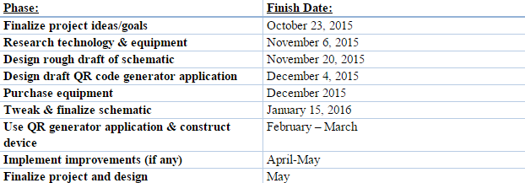
Schedule

Slide 5
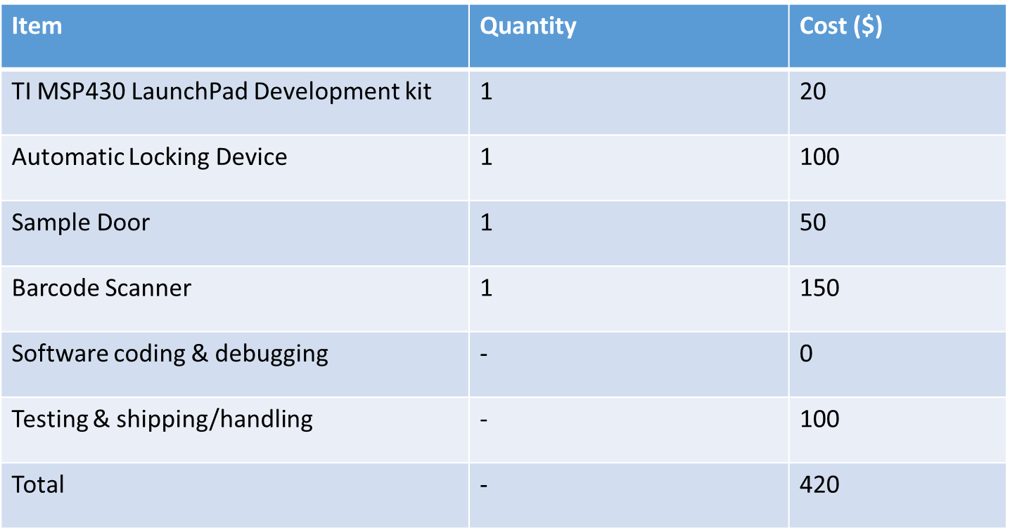
Budget (Actual vs Projected)
Item | Quantity | Cost ($)
Arduino Uno | 1 | 30
Door Lock & Hinges | 1 | 20
Sample Door | 1 | 0
Barcode Scanner | 1 | 15
Software coding & debugging | - | 0
Testing & shipping/handling | - | 0
Total | - | 65

Slide 6

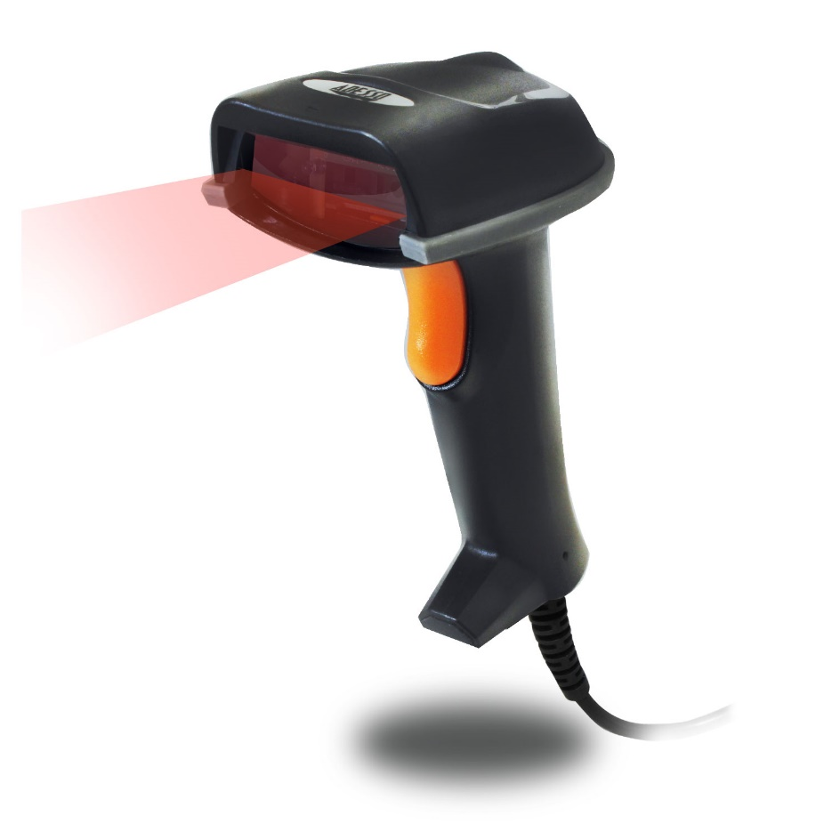

Product

Slide 7
How It Works
User registers on app
Info is sent and stored on database
Barcode is generated for user
User scans barcode to unlock door
Access is only granted if barcode is valid

Slide 8
How It Works – Technically
Parts
  Arduino Uno R3
  Arduino USB Shield
  ESP8266MOD (Wi-Fi Shield)
  Barcode Scanner
  FET
  Breadboard
  Solenoid 12V, 1A
  Android mobile device
Software
  Arduino IDE
  MySQL Workbench
  Amazon Web Services (AWS)
  Android Studio IDE
  WinSCP(file transmission)

Slide 9
Benefits
Major convenience via companion app
  User-Friendly
  Everything at your finger tips
  No key required
Peace of mind – Security
  AmazonWebServices is secure and safe
  Valid barcode is required to gain access

Slide 10

The Future
Our goal – Implement what we developed into a system in a school setting where professors will grant students access into a classroom
Robert Vance Hall
Source: (www.ccsu.edu)

Slide 11
ScanMeIn Final Product concepts/features
More features added to app
  App differentiates between teacher and student
  Teacher will allow student a set time access to room
    Then barcode expires
  Online Interface so teachers can schedule students
Increased security
  User info will be logged and stored
  Database will be on a dedicated encrypted server
  Implementation of more advance algorithm to decide if user is valid or not

Slide 12
Overview
In this project we exercised the skills and knowledge we’ve learned from a number of different courses here at Central Connecticut.
-Building the circuit using our knowledge from Circuit Analysis
-Coding the app using our knowledge from Computer Science
-Debugging and troubleshooting skills acquired from being mentored by the engineering professors.

Slide 13
Obstacles
During the process of developing this product we encountered numerous road blocks, alas we were able to overcome them.
-Database Issues: Trying to use our first database and trying to get it up and running, and then trimming the return statement from executing the query.
Solution: Changed to AmazonWebServices RDS database
-Arduino Issues: Trying to get the Arduino ESP to connect to the database when the MySQL library caused problems with our code, and trying to get it to connect without using php scripts.
Solution: Used an Arduino Developers' library containing methods to connect to the database, mixing implementations around the MySQL library for the ESP Wi-Fi shield.

Slide 14
Accomplishments
Created an online database that we can use to store and manipulate user data information.
Created an android application that allowed users to register for an account, login using their account credentials, and upon successful login – when the barcode is scanned the door will open.
Was able to get the Arduino to communicate with a barcode scanner as well as analyze and compare user information by accessing it within the database.
Found a way to convert a scanned value into a different datatype to insert it via parameter into a query to be executed on the database.

